Slide 1

CS 5435: Asymmetric cryptography (part 2)
Instructor: Tom Ristenpart
https://github.com/tomrist/cs5435-fall2019

Slide 2
Where we’re at
Last time: key exchange, key transport, public-key encryption, forward secrecy, Diffie-Hellman, man-in-the-middle attacks
Today’s lecture
Digital signatures
Public-key infrastructure (PKI)

Slide 3

TLS handshake for Diffie-Hellman Key Exchange
Client
Server
ClientHello, MaxVer, Nc, Ciphers/CompMethods
Pick random Nc
Check CERT
using CA public
verification key
Check σ
ServerHello, Ver, Ns, SessionID, Cipher/CompMethod
Pick random Ns
CERT = (pk_{s} , signature over it)
Pick random x
X = g^{x} mod p
p , g , X , σ = Sign(sk_{s}, p || g || X)
Pick random y
Y = g^{y} mod p
Y
PMS = g^{xy} mod p
ChangeCipherSpec,
{ Finished, PRF(MS, “Client finished” || H(transcript)) }
PMS = g^{xy} mod p
ChangeCipherSpec,
{ Finished, PRF(MS, “Server finished” || H(transcript’)) }
Bracket notation
means contents
encrypted
MS <- PRF(PMS, “master secret” || Nc || Ns )

Slide 4
Man-in-the-middle attacks
Suppose authentication vulnerability:
CERT can be forged, Client doesn’t check CERT, etc.
ClientHello
ClientHello
ServerHello
ServerHello
Client
Server
CERT’ = (pk*, signature over it)
CERT = (pk_{S} , signature over it)
p, g, X*, Sign(sk*, Nc||Ns||p||g||X*)
p, g, X, Sign(sk_{S} , Nc||Ns||p||g||X)
Y
Y*
Attacker can choose X*, Y*, so it knows discrete logs
Completes handshake on both sides
Client thinks its talking to Server
All communications decrypted by adversary, re-encrypted and forwarded to server

Slide 5
Digital signatures
key generation
Kg
R_{k}
sk
pk
R
Sign
M
Ver
S
0 / 1
M
S
Anyone with public key can verify a signature
Only holder of secret key should be able to generate a signature

Slide 6

Digital signatures
M, S
sk
pk
Sender
Receiver
Two algorithms:
Key generation outputs (pk,sk)
Sign (sk,M) outputs a signature S (may be randomized)
Ver(pk,M,S) outputs 0/1 (invalid / valid)
Correctness: Ver(pk,M,Sign(sk,M)) = 1 always
Security: No computationally efficient attacker can forge valid signature for a new message even when attacker gets
(M₁ , S₁ ) , (M₂ , S₂ ), … , (M_{q} , S_{q})
for messages of his choosing and reasonably large q.

Slide 7
Digital signatures
M, S
sk
pk
Sender
Receiver
“Raw” RSA as a signature scheme:
Key generation gives (N,e) , (N,d) s.t. (Me)^{d} mod N = M
Sign((N,d),M) = M^{d} mod N Verify((N,e),M,S) checks if S^{e} mod N = M
Secure?
M = 1
Then S = 1 valid
Get S₁ = M^{d} mod N
Then S = (M^{d})² mod N is valid signature for M²
No!

Slide 8
PKCS #1 v1.5 RSA signing
Kg outputs (N,e),(N,d) where |N|₈ = n
Want to sign using hash with output length m bytes
Let p = n – m - 3
(N,d)
Sign((N,d), M)
Y = 00 || 01 || FF^{p} || 00 || H(M)
Return Y^{d} mod N
Sign
M
S
Verify((N,e), M, S )
Y = S^{e} mod N ; aa||bb||cc||dd||h = Y
If (aa ≠ 00) or (bb ≠ 01) or (cc ≠ FF^{p}) or (dd ≠ 00)
Return error
Return H(M) = h
pk
M
Ver
0 / 1
S

Slide 9
PKCS#1 v1.5 digital signature security
Padding oracle attacks:
PKCS#1 v1.5 decryption oracle can be used to forge
PKCS#1 v1.5 signing oracle can be used to forge
If one uses same RSA key pair for signing and encryption, then decryption and signing oracles offer similar forging / decryption opportunities
Never use same keys for signing and encryption

Slide 10
Full Domain Hash RSA
Kg outputs pk = (N,e) , sk = (N,d) where |N|₈ = n
H is hash with m-byte output k = ceil( (n – 1)/m )
(N,d)
Sign((N,d), M )
X = 00 || H(1||M) || … || H(k||M)
S = X^{d} mod N
Return S
Sign
M
S
Ver((N,e), M, S )
X = S^{e} mod N
X’ = 00 || H(1||M) || … || H(k||M)
If X = X’ then
Return 1
Return 0
(N,e)
M
Ver
0 / 1
S
Probabilistic Signature Scheme (PSS) variant of FDH that is widely deployed
see PKCS#1 v2

Slide 11
Digital signatures from discrete log
Schnorr signatures
Digital Signature Algorithm (designed by DSA)
Variant of Schnorr signatures designed by NSA
ECDSA
Elliptic curve variant of DSA
Reference slides describing included at end of lecture

Slide 12


Certificate Authorities & Public-Key Infrastructure
Verify that request emanating from amazon.com
Installed with client, e.g., browsers maintain list of CA keys
(pk,sk)
Give me a certificate
for pk’, please
pk
M = (pk’,data)
S = Sign(sk,M)
S
http://amazon.com
pk’, data, S
M = (pk’,data)
If Ver(pk,M,S) then
trust pk’
(pk’,sk’)

Slide 14
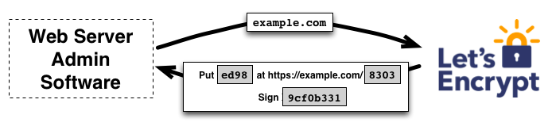
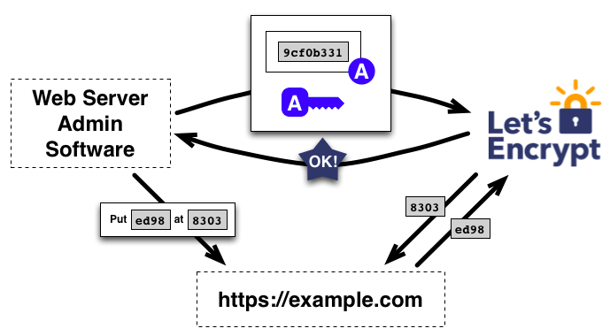
Free CAs

Slide 15
In-class exercise
Discuss with neighbor for 5 minutes:
What vulnerabilities would undermine server authentication in TLS? Think about:
Certificate authority protocols
TLS handshake
Client implementation vulnerabilities
Theft of server secret signing key
Compromise of web server
CA compromise
CA identity check failure

Slide 16
Client side vulnerability: Apple iOS <7.0.16 signature verification code

Slide 17

Web server vulnerability: Heartbleed
Echo “tom” to me, 3 letters
“tom”
Echo “tom” to me, 1000 letters
“tomjBjkfldsmbklajfdsafkjdsbasdf….”
Returns dump of openssl process memory, including secrets
Software vulnerability in openssl’s implementation of heartbeat protocol
Buffer overread vulnerability
Allowed exfiltrating server signing keys
In code base 2012-2014

Slide 18
PKI ecosystem
Durumeric et al. Analysis of the HTTPS Certificate Ecosystem, 2013
http://conferences.sigcomm.org/imc/2013/papers/imc257-durumericAemb.pdf
“1,800 entities that are able to issue certificates vouching for the identity of any website”

Slide 19
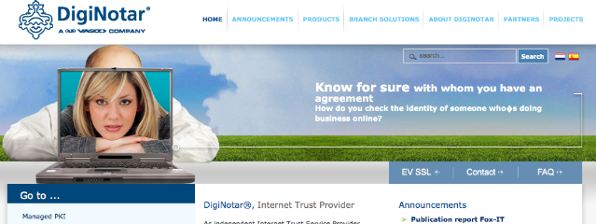
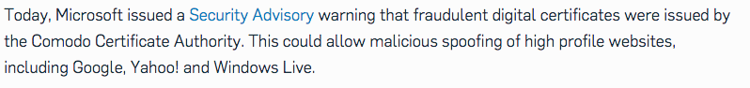
https://nakedsecurity.sophos.com/2011/03/24/fraudulent-certificates-issued-by-comodo-is-it-time-to-rethink-who-we-trust/
https://technet.microsoft.com/library/security/2524375

Slide 21
Revocation
Certificates must often be revoked
Short expirations
CRLs (Certificate revocation lists)
OCSP (online certificate status protocol)
Client queries CA to check on validity of cert
privacy concerns, performance / scalability issues
Stapling: server periodically gets fresh, time-stamped OCSP signature from CA. Sends to clients

Slide 22
How well does revocation work?
Liu et al. An End-to-End Measurement of Certificate Revocation in the Web’s PKI, 2014
http://www.ccs.neu.edu/home/cbw/static/pdf/liu-imc15.pdf
8% of in-use certificates revoked
Many browsers don’t bother checking for revocation (accepting revoked certificates)

Slide 23
Certificate/public-key pinning
Can we prevent MitM due to PKI being undermined?
Client knows what cert/pk to expect, rejects otherwise
Pre-install some keys
HPKP (HTTP Public Key Pinning)
HTTP header that allows servers to set a hash of public key they will use
Public-Key-Pins:
pin-sha256="d6qzRu9zOECb90Uez27xWltNsj0e1Md7GkYYkVoZWmM=";
pin-sha256="LPJNul+wow4m6DsqxbninhsWHlwfp0JecwQzYpOLmCQ=";
max-age=259200
https://developers.google.com/web/updates/2015/09/HPKP-reporting-with-chrome-46?hl=en

Slide 24
Certificate transparency
Can we detect rogue certificates?
Force CAs to log the certificates they sign in a public tamper-evident register
Experimental IETF standard
Google has been pushing this
Chrome requires it for “extra validation” certs
DigiCert has implemented

Slide 25
Summary
Digital signature schemes power PKI and verifying identities:
unforgeability under chosen message attack
RSA based schemes PKCS#1 1.5, FDH, PSS
Discrete-log based schemes include Schnorr, DSA, ECDSA
Web PKI relies on various trust assumptions
Can be undermined in many ways
Need combination of cryptography plus other mechanisms

Slide 27
Groups for Schnorr and DSA Signatures
Let p be a large prime number
Let q be a prime such that q divides p-1
Example: p = 2q + 1 (so-called safe prime p)
Fix the group G = Z_{p} = {1,2,3,…, p-1}
Let g be generator of sub-group of order q:
How to pick g?
g = h^{(p-1)/q} mod p for some h and check g ≠ 1 mod p
If so, try repeat with another h. Usually start with h = 2
*
{ g⁰, g¹, g², … , g^{q-1} } subset of G

Slide 28
(Variant of) Schnorr signatures
p,q,g specified
sk = x chosen randomly from Z_{q} pk = X = g^{x}
Sign(x, M )
r <-$ Z_{q}
R = g^{r} ; c = H(M || R) ; z = r + cx mod q
Return (R,z)
Ver(X, M, (R,z) )
c = H(M || R)
If g^{z} = RX^{c} then Return 1
Return 0
Correctness?
g^{z} = g^{r + cx} = g^{r}g^{xc} = RX^{c}

Slide 29
Security intuition
Assume an adversary that can output forgery (M,(R,z))
Then to be valid:
g^{z} = RX^{c} implies z = r + cx
for c = H(M || R) .
Assume c is random (H is random oracle)
Imagine we can run adversary twice but force forgery to be on same R, different c .
In second execution, getting (M’,(R,z’))
Then success second time around gives:
g^{z’} = RX^{c’} implies z’ = r + c’x
But now can compute z - z’ / (c - c’) = x the secret key

Slide 30
Fragility of signatures
Repeat randomness failure:
Sign two messages M ≠ M’ and reuse randomness
Sign(x,M) -> (R,z)
Sign(x,M’) -> (R,z’)
= (R, r + cx mod q)
= (R, r + c’x mod q)
Then: x = (z - z’) / ( H(M||R) - H(M’||R) )
If r is predictable/leaked, can recover secret from (R,z)
Can improve security by “hedging”:
choose r = H( x || M || randomness )

Slide 31
Actual Schnorr signatures
p,q,g specified
sk = x chosen randomly from Z_{q} pk = X = g^{x}
Sign(x, M )
r <-$ Z_{q}
R = g^{r} ; c = H(M || R) ; z = r + cx mod q
Return (c,z)
Ver(X, M, (c,z) )
R’ = g^{s} X^{-c}
c' = H(M || R’)
If c’ = c then Return 1
Return 0
Correctness?
R’ = g^{s}X^{-c} = g^{r + cx} g^{x/(H(M||R))} = g^{r}

Slide 32
DSA (digital signature algorithm)
p,q,g specified
sk = x chosen randomly from Z_{q} pk = X = g^{x}
Sign(x, M )
r <-$ Z_{q} ; R = (g^{r} mod p) mod q
z = r ⁻¹ ( H(M) + x R ) mod q
Return (R,z)
Ver(X, M, (R,z) )
w = z⁻¹ mod q
u1 = H(m) * w mod q
u2 = R*w mod q
If R = (g^{u1} X^{u2} mod p) mod q
then Return 1
Else Return 0
Correctness?
g^{u1} X^{u2} = g^{H(M) w} g^{x R w} = g^{(H(M)+xR) w}
= g^{(H(M)+xR) (H(M)+xR) r} = g^{r}
-1

Slide 33
Fragility of DSA
Repeat randomness failure:
Sign two messages M ≠ M’ and reuse random
Sign(x,M) -> (R,z)
Sign(x,M’) -> (R,z’)
= (R, r ⁻¹ ( H(M) + x R ) mod q )
= (R, r ⁻¹ ( H(M’) + x R ) mod q )
Then: Solve for r ⁻¹, solve for x
If r is predictable/leaked, can recover secret from (R,z)
Again, can improve security by “hedging”:
choose r = H( x || M || randomness )

Slide 34
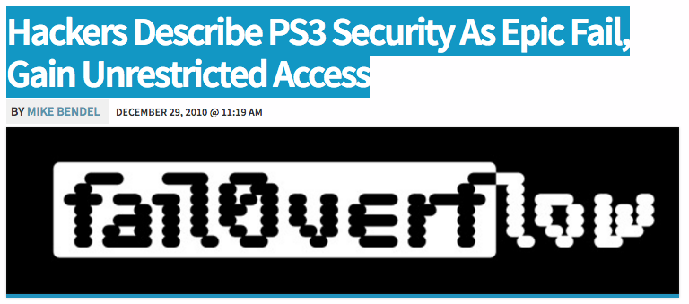
http://psx-scene.com/forums/content/sony-s-ps3-security-epic-fail-videos-within-581/

